Slide 1
Discussion on
Finance Bill (No 2) 2024 -
--------------------------------
Proposals relating to Indirect Taxes
CA. Prasanna Krishnan. V
Chennai

Slide 2
A quick understanding in respect of taxes and national economy…

Slide 3
Indirect Tax collections in Rs (Crores)
TAX SOURCE | 2022-23 Revised | 2022-23 Original | 2023-24 Budgeted | 2023-24 Revised | 2024-25 (1) Budgeted | 2024-25 (2) Budgeted
Customs | 210000 | 213272 | 233100 | 218680 | 231310 | 237745
Cen.Excise | 320000 | 322724 | 339000 | 308100 | 323480 | 324000
Service Tax | 1000^ | 431^ | 500^ | 500^ | 100^ | 100^
GST | 854000 | 849132 | 956600 | 956600 | 1067650 | 1061899

Slide 4
What is the DT: IDT ratio (2024-25) –
Out of total tax revenue (Budgeted) for the year Rs. 38,40,170 (Revised 2023-24 34,37,211 Crore), expected indirect tax collection is ~ Rs. 16,23,744 crores
(about 47.24%)
(Revised 2023-24 ~ 43.17%)].

Slide 5
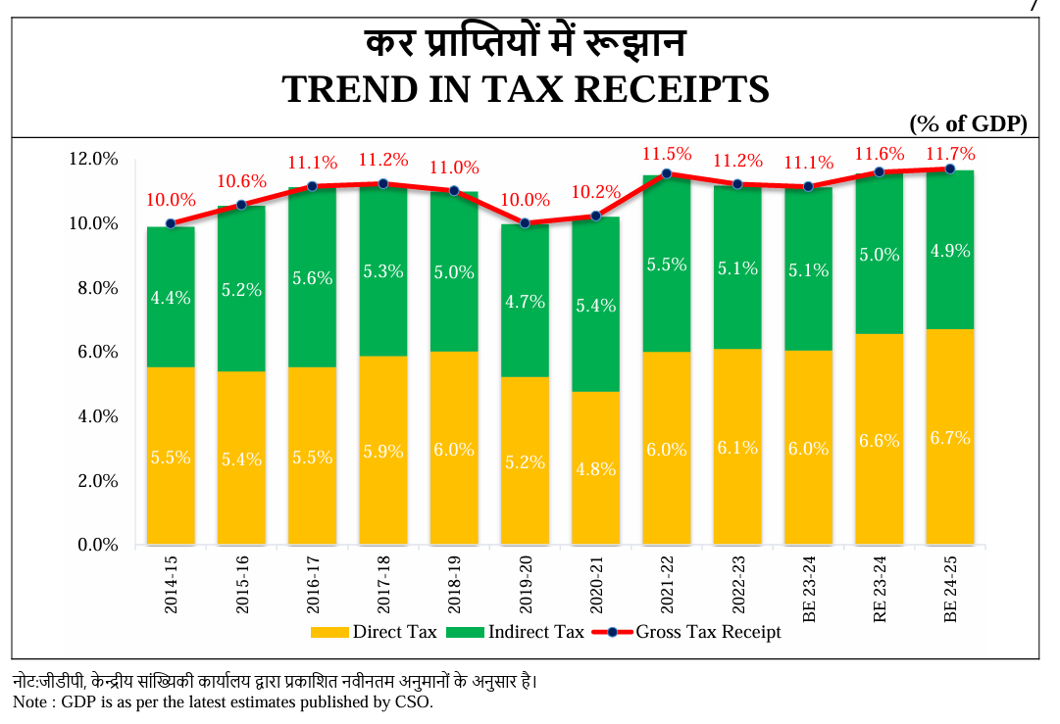

Slide 6
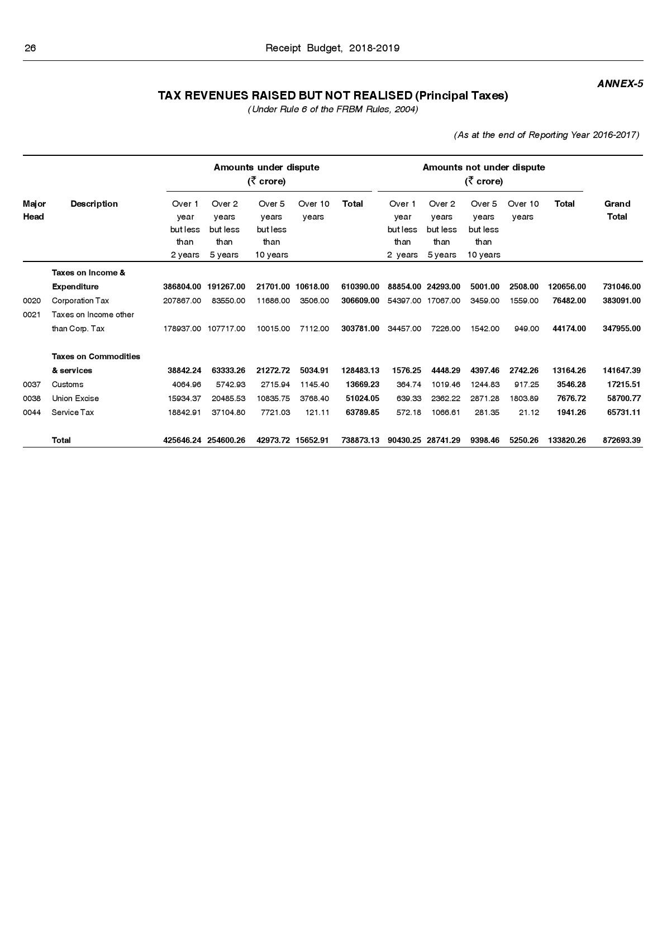
Disputed and Undisputed tax demands - 2017

Slide 7
Disputed and Undisputed tax demands - 2018

Slide 8
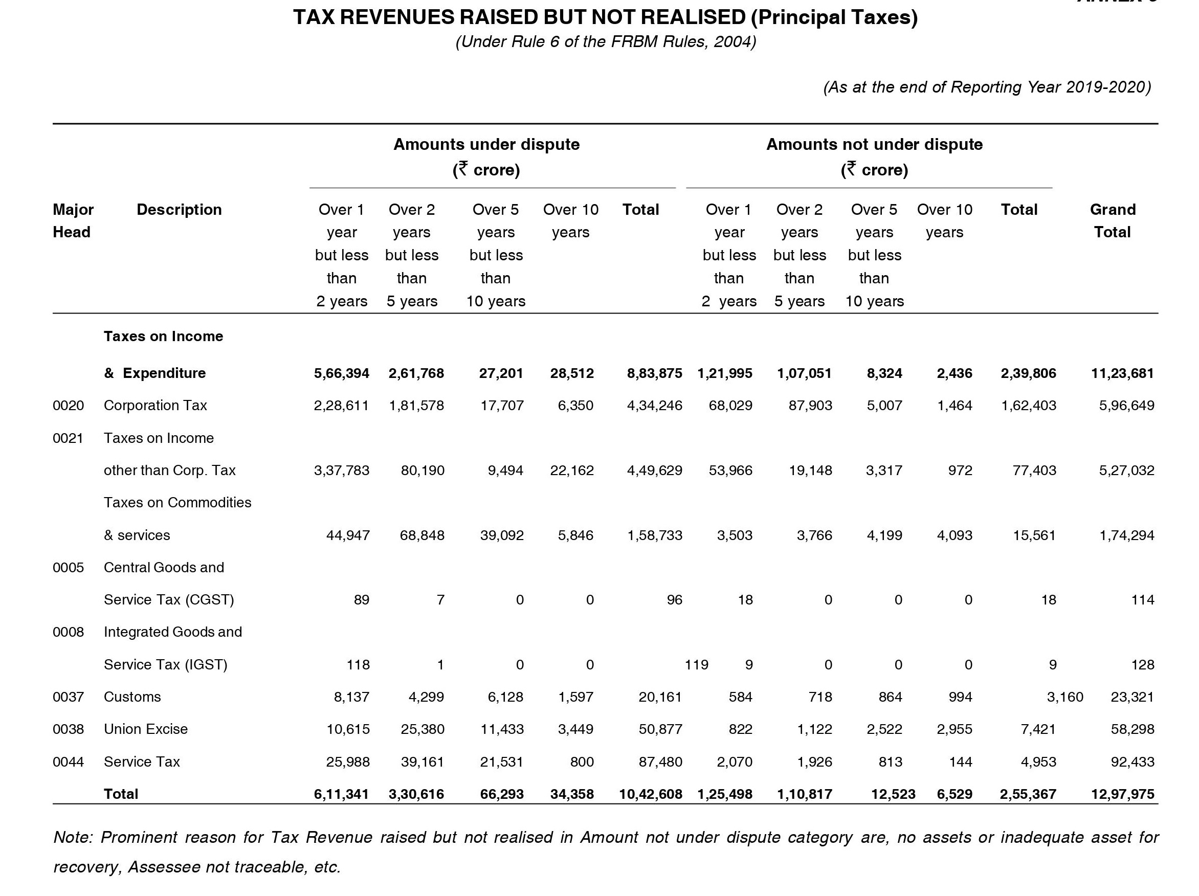
Disputed and Undisputed tax demands - 2020

Slide 9
Disputed and Undisputed tax demands - 2021

Slide 10
Disputed and Undisputed tax demands - 2023

Slide 11
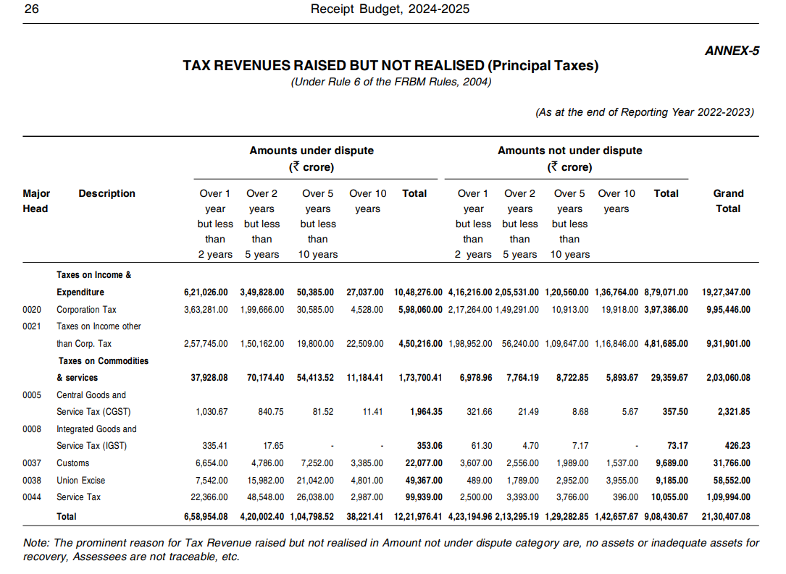
Disputed and Undisputed tax demands - 2024

Slide 12
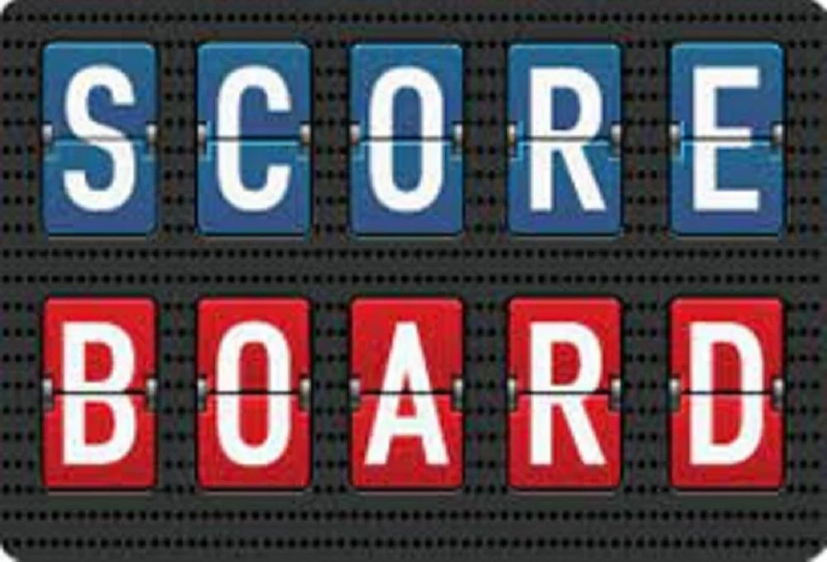
Amendments in different statutes –
Customs Act – 6
Customs Tariff Act – 2
Central Excise Act -2
CGST Act – 28
UTGST Act – 2

Slide 13
Goods and Service Tax statutes –
Amendments

Slide 14
Cl. No 110 -
The Bill seeks to amend sub-section (1) of section 9 of the Central Goods and Services Tax Act, so as to not to levy central tax on un-denatured extra neutral alcohol or rectified spirit used for manufacture of alcoholic liquor for human consumption.
Note the History, Reason and VAT effect.
-----------------------------------------------
Sec 5 (1) of IGST Act 2017 amended in line with the above.

Slide 15
In the case of State of U.P. v. Modi Distillery [(1995) 5 SCC 753], the Apex Court relied upon the judgment of Constitution Bench in the case of Synthetics and Chemicals Ltd. and held that the State can levy excise duty only upon alcoholic liquor fit for human consumption (when its manufacturing is complete) and not upon the raw material or input which is in the process of manufacturing to make it fit for human consumption.
Note what happened in Re: Bihar Distillery Vs UoI (SCC), Deccan Sugar & Akbari Co Ltd. v. Commissioner of Excise (SCC) too.
A brief on Re: Jain Distilleries Vs UoI (All. HC) and first case on constitutional validity is warranted herein too.

Slide 16
Cl. No: 112 -
The Bill seeks to insert a new section 11A in the Central Goods and Services Tax Act, so as to empower the Government to regularise non-levy or short levy of central tax where it is satisfied that such non-levy or short levy was a result of general practice.
Note → What is general practice?
-----------------------------------------------
Sec 6A of IGST Act 2017 brought in too – for effecting the above mentioned

Slide 17
Cl. No: 113 -
The Bill seeks to amend sub-section (3) of section 13 of the Central Goods and Services Tax Act, so as to specify the time of supply of services in cases where the invoice is required to be issued by the recipient of services in reverse charge supplies.
Note → What is the specific need for this amendment now?

Slide 18
Cl. No: 114 –
Section 16 (5) proposed to be inserted –
Notwithstanding anything contained in sub-section (4), in respect of an invoice or debit note for supply of goods or services or both pertaining to the Financial Years 2017 18, 2018-19, 2019-20 and 2020-21, the registered person shall be entitled to take input tax credit in any return under section 39 which is filed upto the thirtieth day of November, 2021
Note → If you filed belated GSTR 3B in the above mentioned years your ITC claimed is assured as mentioned above.
What about your supplier filing belated GSTR 3B and you claiming such ITC?
Not a case of Table 4(A)(5) and table 4(D)(1) of GSTR-3B – Ref: Para 4.3.C of Circular No 170/02/2022-GST, Dated: July 06, 2022

Slide 19
Cl. No: 114 –
Section 16 (5) proposed to be inserted –
(5) Notwithstanding anything contained in sub-section (4), in respect of an invoice or debit note for supply of goods or services or both pertaining to the Financial Years 2017 18, 2018-19, 2019-20 and 2020-21, the registered person shall be entitled to take input tax credit in any return under section 39 which is filed upto the thirtieth day of November, 2021
Note → If you filed belated GSTR 3B in the above mentioned years your ITC claimed is assured as mentioned above.
What about your supplier filing belated GSTR 3B and you claiming such ITC?
Not a case of Table 4(A)(5) and table 4(D)(1) of GSTR-3B – Ref: Para 4.3.C of Circular No 170/02/2022-GST, Dated: July 06, 2022

Slide 20
Cl. No: 114 (Contd) –
What about your supplier filing belated GSTR 3B and you claiming such ITC?
Not a case of Table 4(A)(5) and table 4(D)(1) of GSTR-3B – Ref: Para 4.3.C of Circular No 170/02/2022-GST, Dated: July 06, 2022
Ref: Howrah Tax Payers' Association v. The Government of West Bengal and Anr 2010 (Cal HC)

Slide 21
Cl. No: 114 (Contd) –
A new sub-section (6) in Section 16 proposed to be inserted so as to allow the availment of input tax credit in respect of an invoice or debit note in a return filed for the period from the date of cancellation of registration or the effective date of cancellation of registration, as the case may be, till the date of order of revocation of cancellation of registration, filed within thirty days of the date of order of revocation of cancellation of registration, subject to the condition that the time-limit for availment of credit in respect of the said invoice or debit note should not have already expired under sub-section (4) of the said section on the date of order of cancellation of registration.
The aforesaid amendments are proposed to be made effective from the 1st day of July, 2017. Further it is proposed that where the tax has been paid or the input tax credit has been reversed, no refund of the same shall be admissible.

Slide 22
Cl. No: 115 –
Let us first know what does Section 17 (5) (i), ibid, provide for.
Now the Bill seeks to amend sub-section (5) of section 17 of the Central Goods and Services Tax Act, so as to restrict the non availability of input tax credit in respect of tax paid under section 74 of the said Act only for demands upto Financial Year 2023-24.
It also proposes to remove reference to sections 129 (Tax paid related to goods – a Detention/Seizure case) and 130 (Tax paid related goods - in Confiscation case) in the said sub-section

Slide 23
Cl. No: 115 –
Let us first know what does Section 17 (5) (i), ibid, provide for.
Now the Bill seeks to amend sub-section (5) of section 17 of the Central Goods and Services Tax Act, so as to restrict the non availability of input tax credit in respect of tax paid under section 74 of the said Act only for demands upto Financial Year 2023-24.
It also proposes to remove reference to sections 129 (Tax paid related to goods – a Detention/Seizure case) and 130 (Tax paid related goods - in Confiscation case) in the said sub-section

Slide 24
Cl. No: 118 –
Explanation to Section 31 (3) (g) inserted ––
For the purposes of clause (f), the expression “supplier who is not registered” shall include the supplier who is registered solely for the purpose of deduction of tax under section 51
Government Company GSTDS deductors -> Treat them as ‘Registered, yet not Registered’

Slide 25
Cl. No: 120 –
Explanation to Section 39 (3), ibid ––
Furnishing of E-Return for each month by the registered person required to deduct tax at source, irrespective of whether any deduction has been made in the said month or not.

Slide 26
Cl. No: 124 –
A new sub-section (15) in section 54 of the Central Goods and Services Tax Act proposed to be inserted, so as to omit the second proviso to sub-section (3) and to provide that no refund of unutilised input tax credit or of integrated tax shall be allowed in cases of zero rated supply of goods where such goods are subjected to export duty.
-----------------------------------------------
Cl No 149 –
Sec 16 (5) of IGST Act 2017 inserted in line with the above.

Slide 27
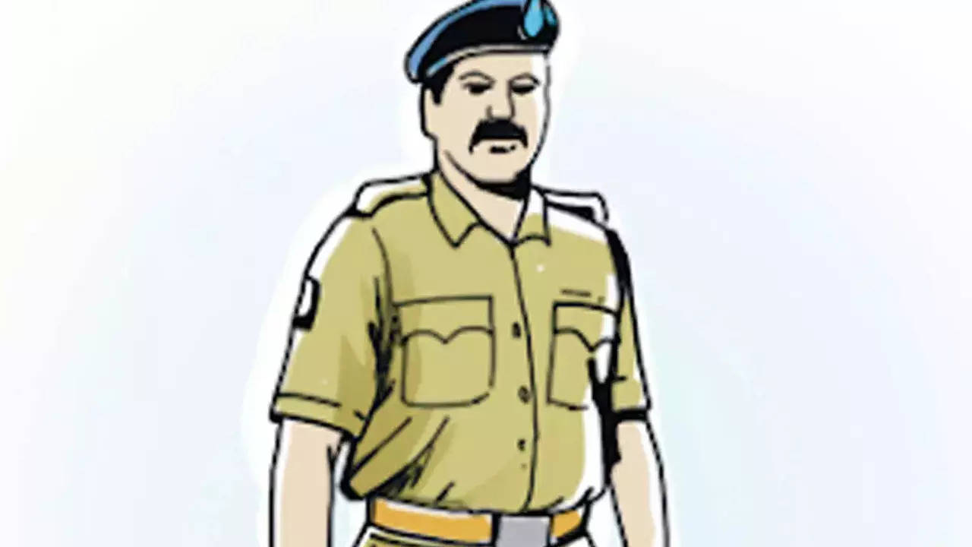
Cl. No: 131 –
A new sub-section (1A) in section 70 of the Central Goods and Services Tax Act inserted, so as to enable an authorised representative to appear on behalf of the summoned person before the proper officer in compliance of summons issued by the said officer.

Slide 28
Cl. No: 132 –
A new sub-section (12) in section 73 of the Central Goods and Services Tax Act, so as to restrict the applicability of the said section for determination of tax pertaining to the period upto Financial Year 2023-24.
It also proposes to amend the marginal heading of the said section accordingly.
Cl. No 133 inserts Sec 74 (12), ibid.

Slide 29
Clause 134 –
A new section 74A in the Central Goods and Services Tax Act to be inserted, so as to provide for determination of tax not paid or short paid or erroneously refunded or input tax credit wrongly availed or utilised for any reason pertaining to the Financial Year 2024-25 onwards.
It also provides for the same limitation period for issuing demand notices and orders in respect of demands from the Financial Year 2024-25 onwards, irrespective of whether the charges of fraud, wilful misstatement, or suppression of facts are invoked or not, while keeping a higher penalty, for cases involving fraud, wilful misstatement, or suppression of facts.

Slide 30
Clause 134 –
A new section 74A –
42 months (from the due date of AR or erroneous refund) for issuing any SCN under this section
Penalty shall be –
Non Fraud Case – Rs 10,000 or 10%, the higher Fraud case -- 100% of tax evaded

Slide 31
Clause 134 –
A new section 74A –
Time to issue Order - 12 months (from the date of issue of SCN U/s 74A (2)
[Extendable by another 6 months - Commissioner or such authorized GSTO not below JC]

Slide 32
Clause 134 –
A new section 74A –
Time to issue Order - 12 months (from the date of issue of SCN U/s 74A (2)
[Extendable by another 6 months - Commissioner or such authorized GSTO not below JC]

Slide 33
Clause 134 –
A new section 74A –
Non Fraud case --
Tax & Interest paid – before issue of SCN and intimated to GSTO – No Notice
Tax & interest paid within 60 days of issue of SCN – Proceedings deemed to be concluded

Slide 34
Clause 134 –
A new section 74A –
Fraud case --
(i) Tax, Int + 15% penalty paid –
before issue of SCN and intimated to GSTO – No Notice
(ii) Tax, Int+ 25% penalty paid
within 60 days of issue of SCN – Proceedings deemed to be concluded

Slide 35
Clause 134 –
A new section 74A –
Fraud case --
(iii) Tax, Int+ 50% penalty paid
within 60 days of communication of Order – Proceedings deemed to be concluded

Slide 36
Clause 134 –
A new section 74A –
Caution – 1
No concessional penalty if it is a case on Self Assessed or Collected GST not paid within 30 days from the due date (Sec 74A (11) )

Slide 37
Clause 134 –
A new section 74A –
Caution – 2
All proceedings shall be deemed to be concluded as mentioned in previous slides. However proceedings U/s 132*, ibid, does not die.
* Case on Bogus invoice/fraudulent refund / bogus ITC, 3 months delayed collected tax etc.

Slide 38
Clause 137 –
Section 107 (6) amended –
The maximum amount of pre-deposit for filing appeal before the Appellate Authority is to be reduced from rupees twenty-five crores to rupees twenty crores in central tax.

Slide 39
Clause 138 –
The Bill seeks to amend section 109 of the Central Goods and Services Tax Act, so as to empower the Appellate Tribunal to examine the matters or adjudicate the cases referred to in sub-section (2) of section 171, if so notified under the said section. Such matters are proposed to be examined or adjudicated only by the Principal Bench.

Slide 40
Clause 142 –
GST Mini Samadhan scheme -
Tax payable as per
(a) a notice issued under sub-section (1) of section 73 or a statement issued under sub-section (3) of section 73, and where no order under sub-section (9) of section 73 has been issued; or
(b) an order passed under sub-section (9) of section 73, and where no order under sub-section (11) of section 107 or sub-section (1) of section 108 has been passed; or
(c) an order passed under sub-section (11) of section 107 or sub-section (1) of section 108, and where no order under sub-section (1) of section 113 has been passed,
pertaining to the period from 1st July, 2017 to 31st March, 2020, or a part thereof
Pay only the Tax – All interest and Penalty waived

Slide 41
What about popular requests of entire Real Estate industry on revisiting valuation / deemed valuation? (Ref: Notification No 11/2017 CT – R, Decision of Hon’ble Gujarat HC in Re: Munjal Manish Bhai Bhat case)

Slide 42
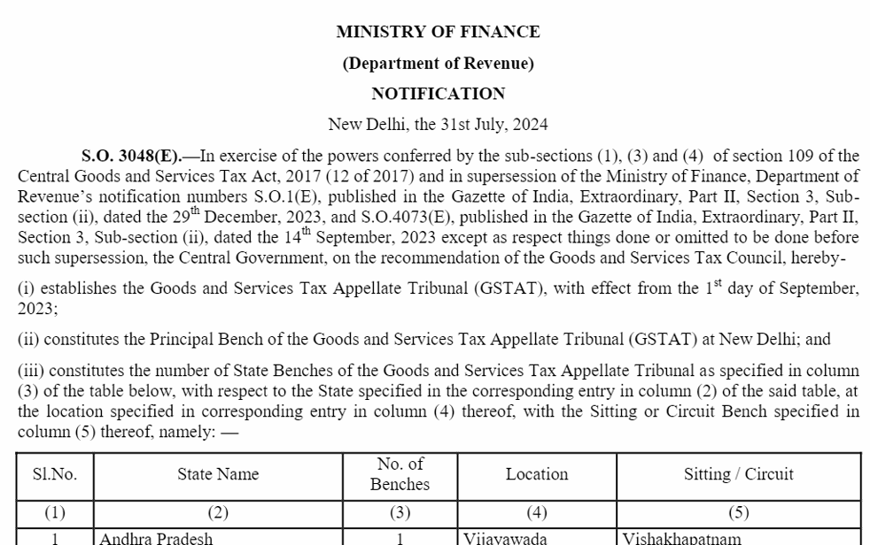
What about bringing in the (effective) GST Appellate Tribunal mechanism as about 7 years passed already from the date of introducing GST in India?
Last night (31 07 2024) Notification issued –

Slide 43
What about popular requests on perfect SOP to be advised to field formation in case of Alleging Ineligible ITC to buyer citing absence of due references caused by seller in former’s GSTR 2B? (Ref: Sec 16 (4) of the Act and Decision of Hon’ble Madras HC in Re: DY Beathel Enterprises case, Hon’ble Kerala High Court in Re: Goparaj Gopalakrishna Pillai - 2023)
# But, Cannot ignore decision of Hon’ble Patna High Court in the case of Aastha Enterprises Vs State of Bihar (2023) too!

Slide 44
What about popular requests on perfect SOP to be advised to the field formations in case of Overlapping Enquiries by multiple investigation agencies (in respect of same tax periods) and/or digitized sharing of given inputs?

Slide 45
Customs Related Amendments

Slide 46
Cl. No 100 –
Section 28 DA is being amended to enable the acceptance of different types of proof of origin provided in trade agreements in order to align the said section with new trade agreements, which provide for self-certification.
Note the Reason.

Slide 47
Cl. No 101 –
A proviso to sub-section (1) of Section 65 is being inserted to empower the Central Government to specify certain manufacturing and other operations in relation to a class of goods that shall not be permitted in a warehouse
Note the Reason.

Slide 48
Cl No 102
Section 143AA of the Customs Act is being amended by substituting the expression "a class of importers or exporters" with "a class of importers or exporters or any other persons" for the purpose of facilitating trade

Slide 49
Cl No 102
Section 143AA of the Customs Act is being amended by substituting the expression "a class of importers or exporters" with "a class of importers or exporters or any other persons" for the purpose of facilitating trade

Slide 50
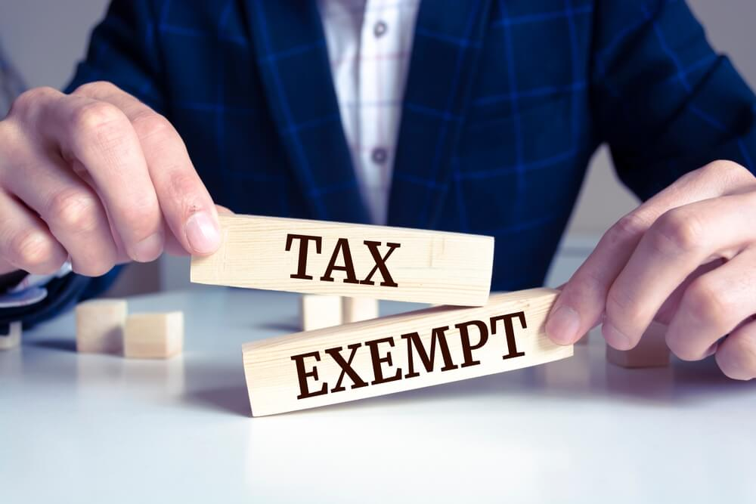
Cl No 104
Based on the recommendation of the GST Council in its 53rd meeting, GST Compensation Cess is being exempted with effect from 1st July, 2017 on imports in SEZ by SEZ units or developers for authorized operations.

Slide 51
Notification No. 38/2024- Customs dated 23.07.2024; -
Currently, articles of foreign origin can be imported into India for repairs subject to their re-exportation within six months extendable to 1 year.
The duration for export in the case of aircraft and vessels imported for maintenance, repair and overhauling has been increased from 6 months to 1 year, further extendable by 1 year

Slide 52
Notification No. 39/2024- Customs dated 23.07.2024
The time-period of duty-free re-import of goods (other than those under export promotion schemes) exported out from India under warranty has been increased from 3 years to 5 years, further extendable by 2 years

Slide 53
Proposed amendment to Notification No.11/2018-Customs., dated 02-02-2018 w.e.f 24.07.2024 ( There are 55 items being exempted from levy of Social Welfare Surcharge)
Proposed amendment to Notification No. 11/2021 – Customs, dated 01.02.2021 is being amended to revise the Agriculture and Infrastructure Development Cess rates on seven goods (w.e.f. 24.07.2024)
Review of conditional exemption rates of BCD prescribed in Notification no. 50/2017-Customs dated 30.6.2017: (i) The BCD exemption for the goods covered under specified serial numbers of the notification are being extended upto 31st March, 2026 (for 117 items).

Slide 54
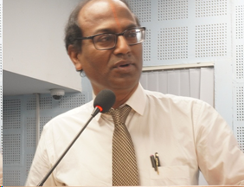
Questions?

Slide 55
THANK YOU!
- CA. PRASANNA KRISHNAN. V
Office:
ca_dpv@yahoo.co.in

